Slide 1
BLEACH GAME
Submitted by:
Jeeshan Shrestha(081bct012)
Pranay Tuladhar(081bct020)
Hari Bahadur Basnet(081bct011)
Submitted to:
Department of Electronics and Computer Engineering
Thapathali Campus
Kathmandu, Nepal
Date:2025/03/12

Slide 2
Introduction
Game Concept
Inspired by the anime Bleach
featuring sword-based combat
Objectives
Defeat enemies
gain points
face the boss
Language Used
C programming

Slide 3
Gameplay Mechanism
Character Movement
Left, Right, Up and Down
Enemy Respawn
Enemies appear from any direction
Attack Mechanism
Sword-based slash attack
Flash-Step (Increases player movement speed)
Scoring
+10 points per defeated enemy.
Boss Fight
After 50 points, the main boss (Aizen) appears
After 1000 points, Game final Boss appears
Boss fires a projectile that stuns player for 1 seconds.

Slide 4
Game Features
Player Lives
10 lives, reduced upon enemy contact and Boss Contact
Progression
Enemies increase in number and difficulty
End Condition
Player loses all lives, or else the game runs infinitely and compete to get the highest score.

Slide 5
Development Process
Programming Language
c
Libraries Used
raylib
stdbool
stdio
Challenges Faced
Implementing movement and enemy AI
Collision detection
Scorekeeping and game progression
Solutions Implemented
Optimized logic
Debugging techniques.

Slide 6
Tools and resources used
IDE
Visual Studio Code
Visual Studio
Version Control
Git
References
Raylib Documentation: https://www.raylib.com/
Bleach Anime: https://www.crunchyroll.com/bleach Game
Development Concepts: https://www.gamedev.net/ Error Debugging: https://chatgpt.com/

Slide 7
Future Improvements
Enhanced Graphics
Using external libraries like SDL
Sound Effects & Music
Adding immersive audios
Multiplayer Mode
Introducing a two-player battle mode
AI Improvements
Smarter enemies with varying attack patterns

Slide 8
Lessons Learned
Programming Skills
Improved C proficiency
Improved skills to write high quality codes
Problem-Solving
Debugging and optimizing code
Patience enhancement and better understanding
Game Development Workflow
Understanding the steps from concept to execution
Making the prototype to implement in on the actual project

Slide 9
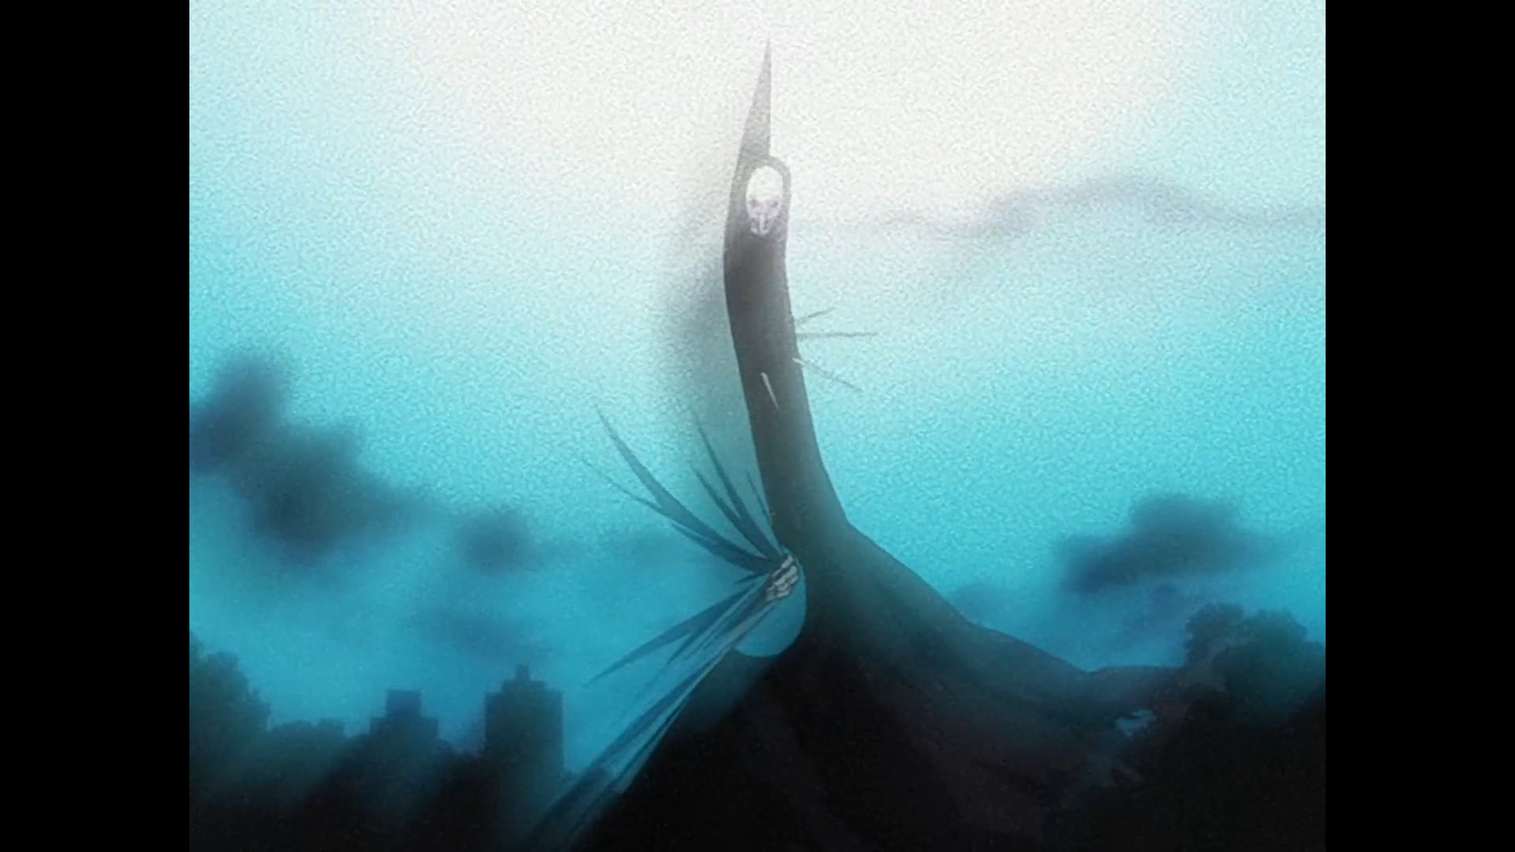



Screenshots / Game Demo
Player Enemy Main Boss

Slide 10
Conclusion & Final Thoughts
Summary
Developed a C-based game with anime-inspired mechanics.
Understood new concepts like deltaTime and gameLoop.
Key Takeaways
Experience in game development, programming logic, and debugging.
Final Words
Excited for future improvements and new projects.

